Slide 1

Handling Concept Drift in Data Streams Getting Ready for Change
Mykola Pechenizkiy
http://www.win.tue.nl/~mpechen/
Beyond Adaptation Dagstuhl Seminar
7 September 2020
Notes:
, Dangers & Opportunities

Slide 2
Outline
What is concept drift (CD)? Why anticipating it?
Categorization of the main-stream approaches for handling different types of CD
Characterization of applications requiring predictive modeling with CD handling
Gaps between research and practice
FAccT motivation for understanding CD
Notes:
Change/concept drift
Recurring change
“All models are wrong. Finding those that are the most useful for this moment.”
Examples, light weight, details on demand.
Context
Context switch

Slide 3
Acknowledgements
This light-weight introduction is based mainly on
Gama, J., Žliobaitė, I., Bifet, A., Pechenizkiy, M., Bouchachia, A. (2014) A Survey on Concept Drift Adaptation, ACM Computing Surveys, 46(4), ACM, pp. 44:1-44:37.
Žliobaitė, I., Pechenizkiy, M., Gama, J. (2016) "An overview of concept drift applications", In Big Data Analysis: New Algorithms for a New Society, Springer, pp. 91-114.
PAKDD-2011 Tutorial on Handling CD by Bifet, A., Gama, J., Pechenizkiy, M., Žliobaitė, I.
Notes:
Characterizing Concept Drift. Webb, G. I., Hyde, R., Cao, H., Nguyen, H. L., & Petitjean, F. Data Mining and Knowledge Discovery, 30(4), 964-994, 2016.
Analyzing concept drift and shift from sample data. Webb, G. I., Lee, L. K., Goethals, B., & Petitjean, F. Data Mining and Knowledge Discovery, 32(5), 1179-1199, 2018.
Survey of distance measures for quantifying concept drift and shift in numeric dataOpens in a new window. Goldenberg, I., & Webb, G. I. Knowledge and Information Systems, 60(2), 591-615, 2019.
PCA-based drift and shift quantification framework for multidimensional dataOpens in a new window. Goldenberg, I., & Webb, G. I. Knowledge and Information Systems, 62, 2835-2854, 2020.

Slide 4
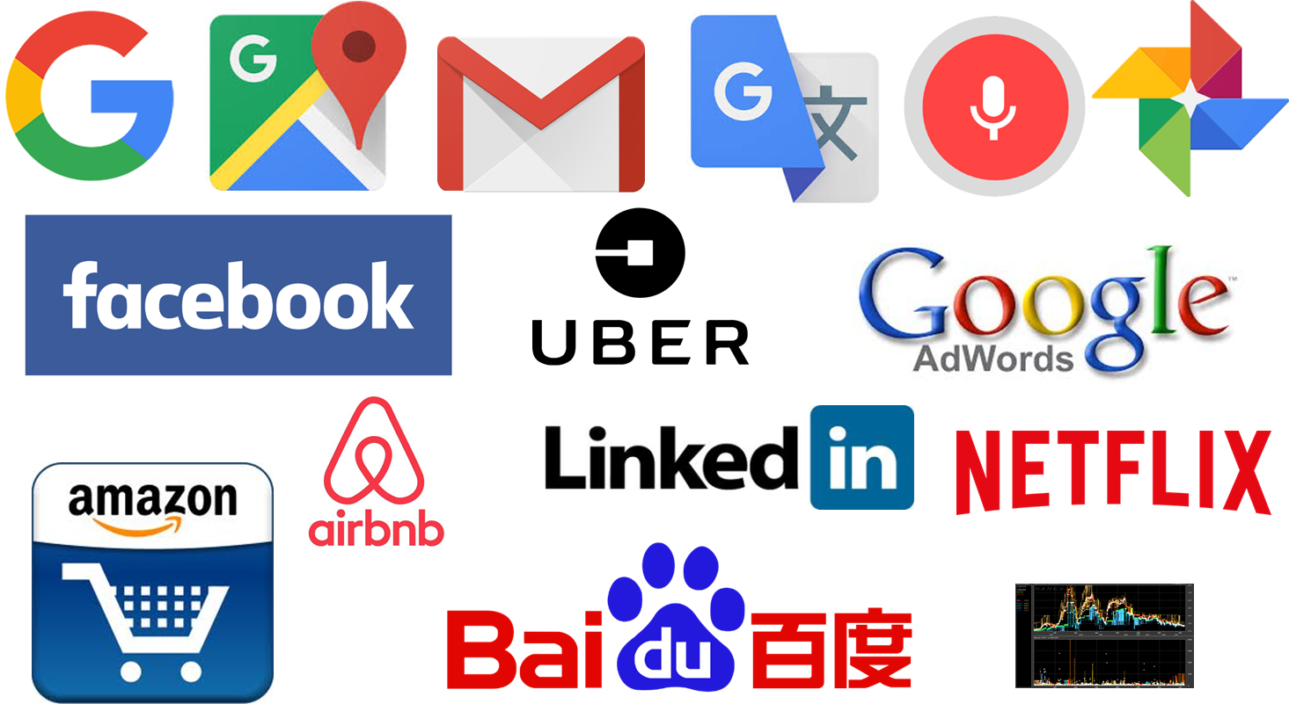
Predictive analytics impacts everyone
Everyday life: services by Google/Facebook/…
Notes:
Massive Automation of Decision Making:
What these services are really optimizing for?
What should/could be made public about how the algorithms work?
Since then we saw several successes of AI in games notably Go and Poker.
Even more successes do not make it to the headlines, but this does not diminish their importance: medical diagnostics, estimating risks, scheduling jobs, giving us relevant search results (and ads of course) …
Artificial general intelligence: artificial brain
Specialized AI: engineering AI for solving particular kinds of problems
Most of the advances in AI are in solving particular kinds of problems, namely predictive modeling
Strong AI/weak AI
Progress in specialized AI is impressive
Optimization tasks: Text classification, object recognition, text translation,
Progress in general AI is not even in its infancy
Text understanding, common-sense reasoning
Why do we hear about Singularity etc?
Everyday life: services by Google/Facebook/…
Navigate a map, Get rid of spam, Transcribe speech, Translate between languages
Find answers in text for factoid questions, Recognize emotions in images, speech, text
Recognize objects in images

Slide 5
Covid & Concept Drift
https://www.technologyreview.com/2020/05/11/1001563/covid-pandemic-broken-ai-machine-learning-amazon-retail-fraud-humans-in-the-loop

Slide 6
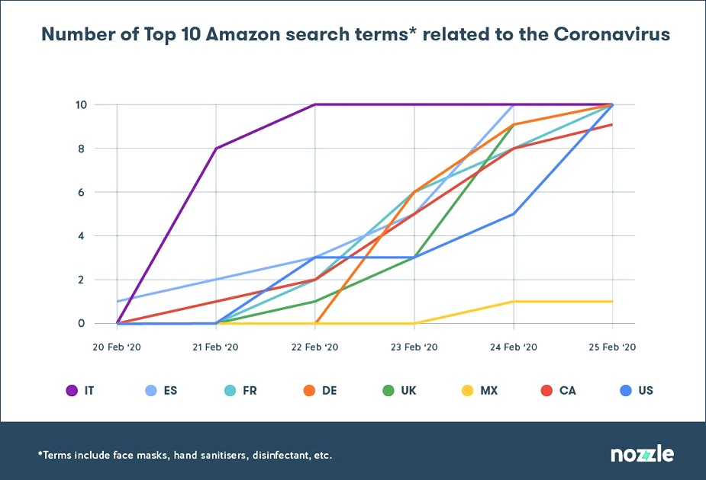
Top 10 search terms on Amazon
toilet paper,
face mask,
hand sanitizer,
paper towels,
Lysol spray,
Clorox wipes,
mask,
Lysol,
masks for germ protection,
N95 mask
Notes:
https://www.technologyreview.com/2020/05/11/1001563/covid-pandemic-broken-ai-machine-learning-amazon-retail-fraud-humans-in-the-loop
When covid-19 hit, we started buying things we’d never bought before.
The shift was sudden: the mainstays of Amazon’s top ten—phone cases, phone chargers, Lego—were knocked off the charts in just a few days.

Slide 7
Supervised Learning
population
(source)
Training:
y = L (X)
Application:
use L
for an unseen data
y' = L (X')
Testing
data
X'
labels
2.
Historical
data
Model L
X
1. training
y
labels
2. application
label?
y'

Slide 8

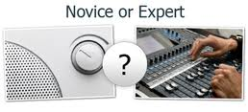
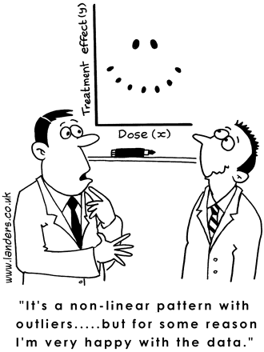

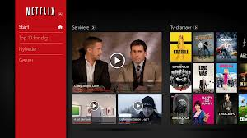
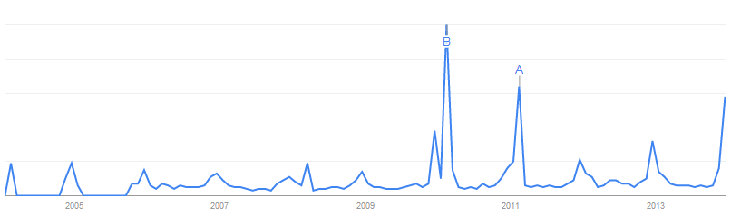
Supervised Learning Tasks
Use some variables to predict unknown or future values of other variables (labeled data needed)
Classification
expert or novice user?
information need: navigational or explorative?
Regression
What score will this user give to this product?
How much is he ready to pay for it?
Ranking and preference learning
What is more important/interesting for a user?
Timeseries prediction
What would be CTR for a news item next day?
Notes:
Descriptive Methods ▪Find human-interpretable patterns that describe the data

Slide 9
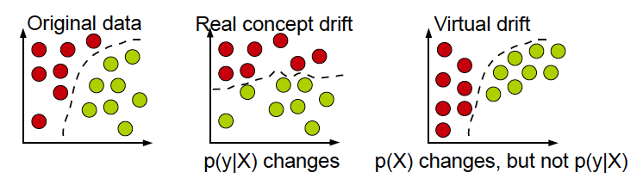
Lots of Approaches for Each Task
From very simple to rather sophisticated
Popular techniques include e.g.
Naïve Bayes, Nearest Neighbor, Decision Trees, Random Forests, SVMs, Logistic Regression, Deep Learning, ARIMA among others
I will focus on classification examples
circles represent instances (X),
different colors – different classes (y)
dashed line – decision boundary (L)
Notes:
8
I will give mostly classification examples to keep the focus, but the discussion is applicable for other predictive modeling and monitoring tasks
a concept is a set of objects

Slide 10
Motivation from real-world examples
Antibiotic resistance prediction
Movie recommendation
Mass-flow prediction
Stress-detection
Credit scoring
Demand monitoring/prediction (food sales, query traffic), and now covid
Notes:
Change/concept drift
Recurring change
“All models are wrong. Finding those that are the most useful for this moment.”
Context
Context switch

Slide 11
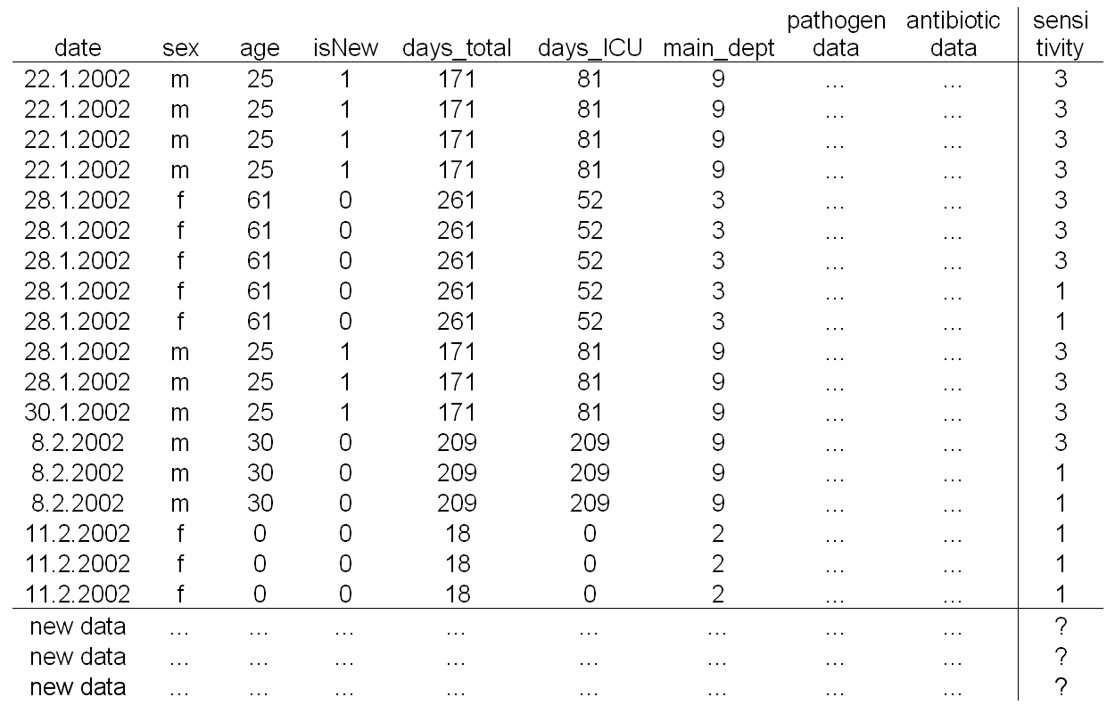
Prediction under Concept Drift
Antibiotic Resistance Prediction:
predict the sensitivity of a pathogen to an antibiotic based on data about the antibiotic, the isolated pathogen, and the demographic and clinical features of the patient.
Notes:
Changes in the population of people vs. changes in the population of pathogens (more and more develop resistance)
(Tsymbal et al., 08)

Slide 12
Where is Concept Drift here?
Pathogen sensitivity may change over time as new pathogen strains develop resistance to antibiotics that were previously effective
Even in most strictly controlled environments some unexpected changes may happen due to:
fail and replacement of some medical equipment
changes in personnel
An effective learner should be able to track such changes and to quickly adapt to them.
Notes:
Changes in hidden context may not only be a cause of a change of target concept, but may also cause a change of the underlying data distribution.
Even if the target concept remains the same, and it is only the data distribution that changes, this may often lead to the necessity of revising the current model, as the model’s error may no longer be acceptable with the new data distribution. The necessity in the change of current model due to the change of data distribution is called virtual concept drift. Virtual concept drift and real concept drift often occur together. From the practical point of view it is not important, what kind of concept drift occurs, real or virtual, or both. In all cases the current model needs to be changed.

Slide 13
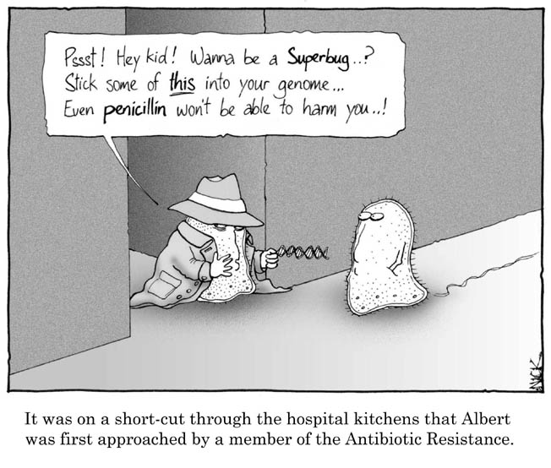
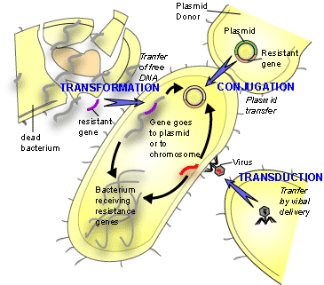
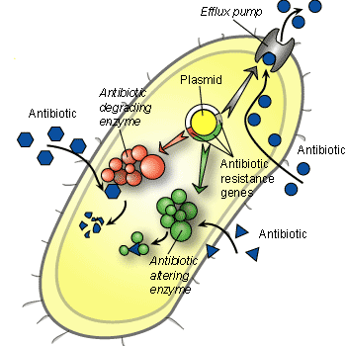
How Antibiotic Resistance Happens
Notes:
Antibiotic resistance results from gene action. Bacteria acquire genes conferring resistance in any of three ways.
Different ways how resistance may happen
Different ways how resistance may spread
Physical connections/hospital organization
Local drift
Solution:
Contextual approach at the instance level
Dynamic integration of classifiers

Slide 14
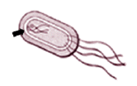
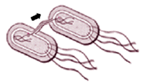
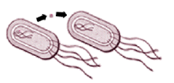
How Antibiotic Resistance Happens
In spontaneous DNA mutation, bacterial DNA may mutate spontaneously. Drug-resistant tuberculosis arises this way.
In a form of microbial sex called transformation, one bacterium may take up DNA from another bacterium. Penicillin-resistant gonorrhea results from transformation.
Resistance acquired from a small circle of DNA called a plasmid, that can flit from one type of bacterium to another.
Notes:
Antibiotic resistance results from gene action. Bacteria acquire genes conferring resistance in any of three ways.
A single plasmid can provide a slew of different resistances.
In 1968, 12,500 people in Guatemala died in an epidemic of Shigella diarrhea. The microbe harbored a plasmid carrying resistances to four antibiotics!

Slide 15




Predictive Analytics on Evolving Data
Data arrives in a stream that never ends
Prediction systems need to be adaptive to changes over time to be up to date and useful
Changes in personal interests or in population characteristics
(adaptive news access)
Adversary activities
(avoiding
spam filters;
credit card fraud)
Changes in
population
characteristics
(credit scoring)
Complexity of
the environment
(driverless cars)
Notes:
Adaptive learning algorithms can be seen as advanced incremental learning
algorithms that are able to adapt to evolution of the data generating process over time.
Prediction systems operate over time
Changes in underlying patterns may happen
Changes may come from different sources
Adversary activities (card fraud)
Changes in population characteristics (credit scoring)
Changes in personal interests (news access)
Complexity of the environment (driverless cars)
Prediction systems need to be adaptive to changes over time to be up to date and useful

Slide 16
Explicit, implicit and hidden contexts
Explicit
time of the day is important and is given in the data
Implicit
discover that e.g. time of the day is important and infer it with some certainty from the data
Hidden
Can neither observe nor derive context affecting
Changes in hidden contexts ⬄ concept drift
Actionable, including adversary actions
Add something appealing to the content
“Registration fees waived” vs. “venue is beach hotel”
Notes:
Also actionable contexts

Slide 17
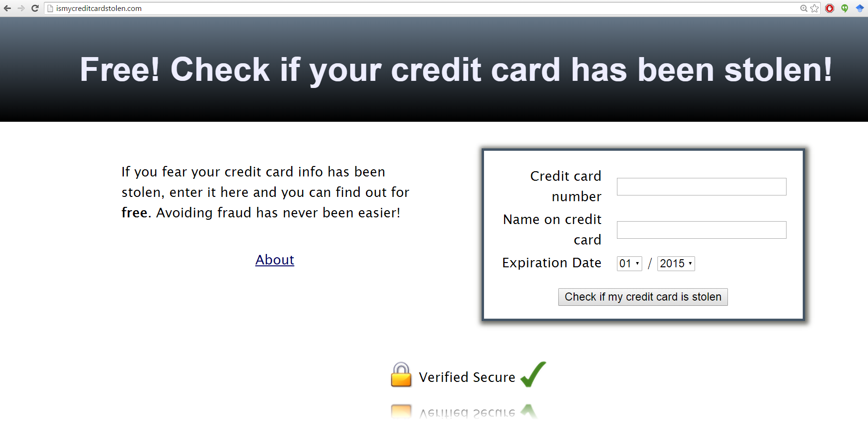
Adversary activities

Slide 18
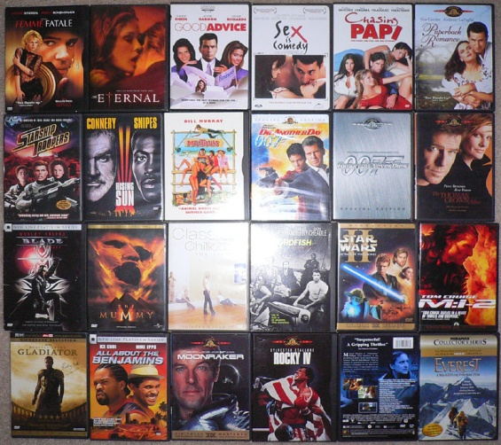
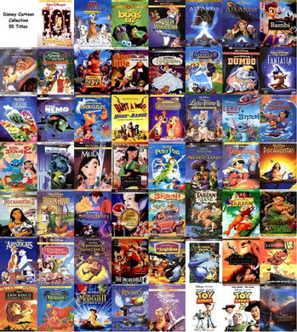
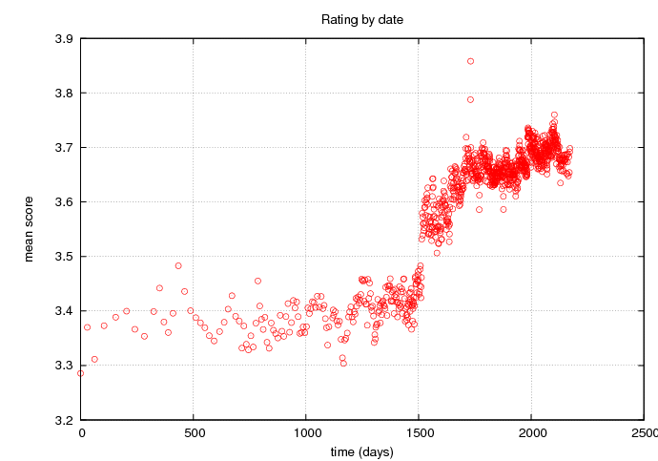



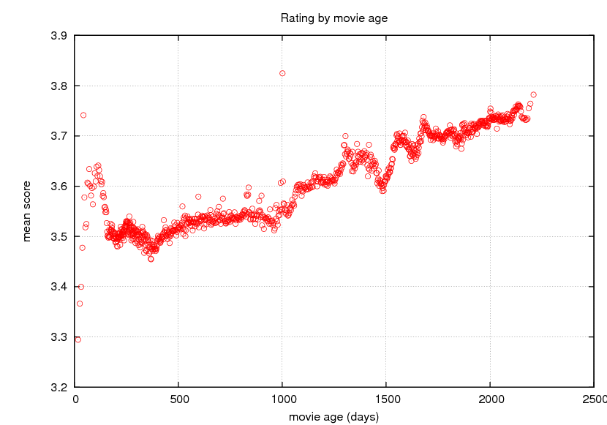

Recommender Systems
Lessons learnt from Netflix competition:
Temporal dynamics is important
Classical CD approaches may not work
(Koren, SIGKDD 2009)
We Know What You Ought To Be Watching This Summer
Something happened in early 2004…
Are movies getting better with time?

Slide 19
Multiple Sources of Temporal Dynamics
Both items and users are changing over time
Item-side effects:
Product perception and popularity are constantly changing
Seasonal patterns influence items’ popularity
User-side effects:
Customers ever redefine their taste
Transient, short-term bias; anchoring
Drifting rating scale
Change of rater within household
Population characteristics: early adopters

Slide 20
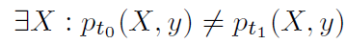
Real vs. Virtual Concept Drifts
circles represent instances (X),
different colors represent different classes (y)
concept drift between t₀ and t₁:
changes that affect the prediction decision require adaptation
Notes:
- the prior probabilities of classes p(y) may change,
- the class conditional probabilities p(Xjy) may change, and
- as a result, the posterior probabilities of classes p(yjX) may change affecting the prediction
the input data characteristics or the relation between the input data and the target variable may change
From a predictive perspective only the changes that affect the prediction
decision require adaptation
The real concept drift refers to changes in
the conditional distribution of the output (i.e., target variable) given the input (input
features), while the distribution of the input may stay unchanged. A typical example
of the real concept drift is a change in user’s interests when following an online news
stream. Whilst the distribution of the incoming news documents often remains the
same, the conditional distribution of the interesting (and thus not interesting) news documents for that user changes.
Originally a virtual drift has been defined [Widmer and Kubat 1993] to occur
due to incomplete data representation rather than change in concepts in reality,
— Virtual drift corresponds to change in data distribution that leads to changes in
the decision boundary [Tsymbal 2004],
— Virtual drift is a drift that does not affect the target concept [Delany et al. 2005],
— Virtual drift has been also referred to as temporary drift [Lazarescu et al.
2004],sampling shift [Salganicoff 1997] and feature change [Gao et al. 2007],

Slide 21
Supervised Learning under Concept Drift
population
= ??
Training:
y = L (X)
Application:
y' = L?? (X')
population
Test
data
X'
Historical
data
Model L
X
y
labels
label?
y'

Slide 22
Adaptive Learning Strategies
Selecting the right training data
or adjusting
the model
?
L_{t+1}
Updated/ new model
More training data is no longer better
now
prediction

Slide 23
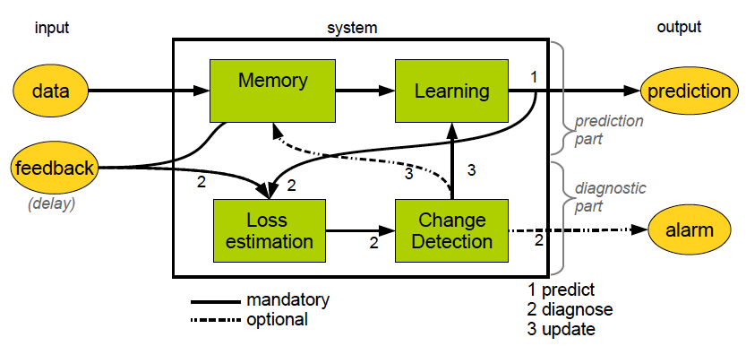
Schema for Online Adaptive Learning

Slide 24
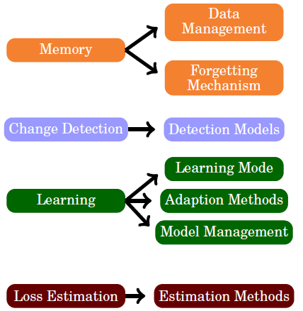
Categorization of Approaches for HCD

Slide 25
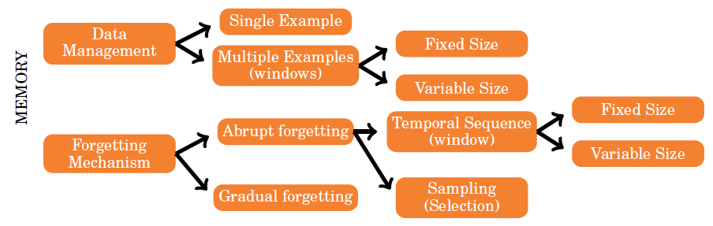
Categorization: Memory Management
X₁
X₂
X₃
X_{t}
X_{t+1}
time
Updated/ new model
L_{t+1}
Memory Management
now
prediction
Notes:
two types of memory:
short term memory represented as data and long term memory represented as
generalization of data – models

Slide 26
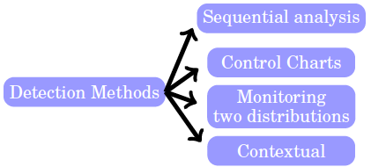
Categorization: Change Detection
CUSUM, PH
SPC
ADWIN
Splice
?
L_{t+1}
Updated/ new model
More training data is no longer better
now
prediction
Notes:
Splics - The idea is to use a time-stamp
of the examples as an input feature to a batch classifier. In the first stage examples
are augmented with a time-stamp feature, and a decision tree is learned. If the decision
tree finds splits on the time-stamp feature, the partitions on that feature suggest
different contexts.

Slide 27
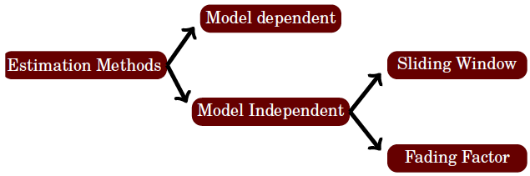
Categorization: Loss Estimation
LOOCV SVM

Slide 28
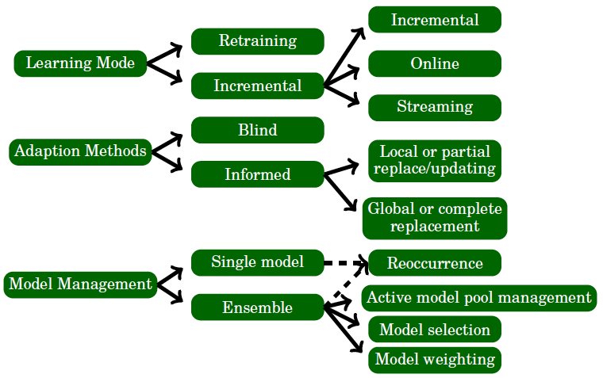
Learning Properties of Methods
Notes:
In such settings, instead of discarding
outdated models, it might be useful to store the learned models in a sleeping
mode. Following this idea, the work presented in [Gama and Kosina 2011], discuss a
generic framework that identifies context using drift detection, characterizes contexts
using meta-learning, and select themost appropriate predictive model for the incoming
data using unlabeled examples.

Slide 29
Techniques to Handle Concept Drift
Triggering
Evolving
Single classifier
Detectors
Forgetting
variable windows
fixed windows,
Instance weighting
Ensemble
Dynamic ensemble
Contextual
adaptive
fusion rules
dynamic integration,
meta learning

Slide 30
Techniques to Handle Concept Drift
Triggering
Evolving
change detection and a follow up reaction
adapting every step
Single classifier
Detectors
Forgetting
variable windows
fixed windows,
Instance weighting
Ensemble
Dynamic ensemble
Contextual
adaptive
fusion rules
dynamic integration,
meta learning

Slide 31
Techniques to Handle Concept Drift
reactive, forgetting
Triggering
Evolving
Single classifier
Detectors
Forgetting
variable windows
fixed windows,
Instance weighting
Ensemble
Dynamic ensemble
Contextual
maintain some memory
adaptive
fusion rules
dynamic integration,
meta learning

Slide 32
Closer Look
Triggering
Evolving
Forget old data and retrain at a fixed rate
Single classifier
Detectors
Forgetting
fixed windows,
Instance weighting
Ensemble
Dynamic ensemble
Contextual

Slide 33
Fixed Training Window
time

Slide 34
Closer Look
Triggering
Evolving
Detect a change and cut
Single classifier
Detectors
Forgetting
variable windows
Ensemble
Dynamic ensemble
Contextual

Slide 35
Variable Training Window

Slide 36
Change Detection
Where to look for a change?
input
output
model
performance
monitoring
techniques that handle the real CD can also handle CDs that manifest in the input, but not the other way around

Slide 37
Change Detection
input
output
model
performance
monitoring
multivariate input data
statistical change detection

Slide 38
Change Detection
input
output
model
performance
monitoring
change
in the learned rules
over time

Slide 39
Change Detection
monitor model outputs or streaming error
univariate statistical tests
input
output
model
performance
monitoring

Slide 40
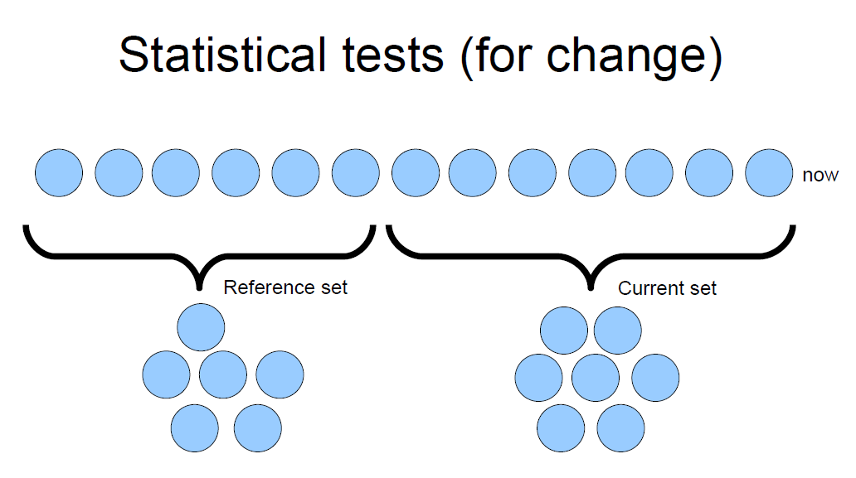
Forming Test Samples
time
input,
model parameters,
output or
error instance

Slide 41
Forming Test Samples
time

Slide 42
Detection
change point
new window
compare using
a statistical test

Slide 43
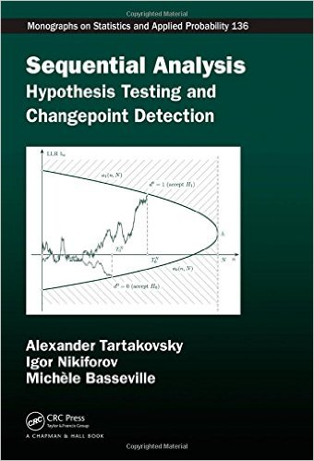
Change detectors

Slide 44
Change Types
Notes:
Besides: local change, blip drift is a special case of abrupt drift coupled with very short concept
duration.
43

Slide 45
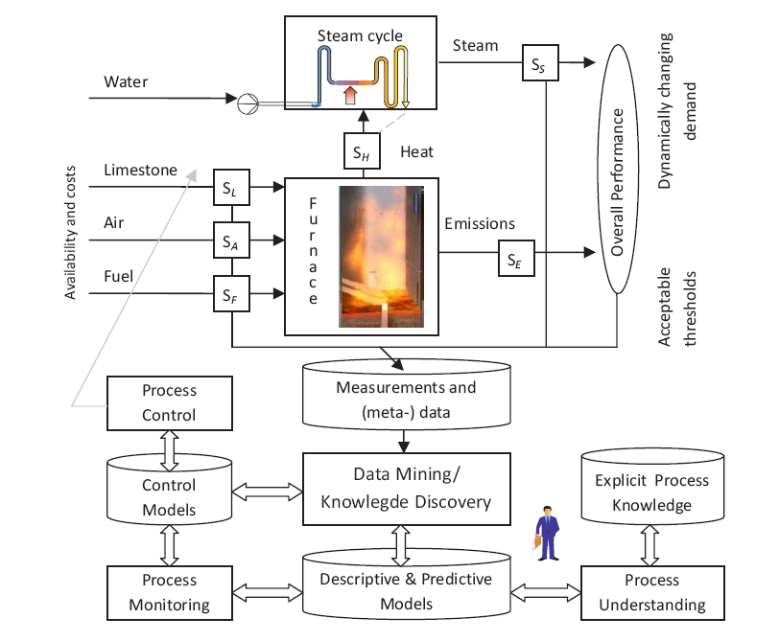
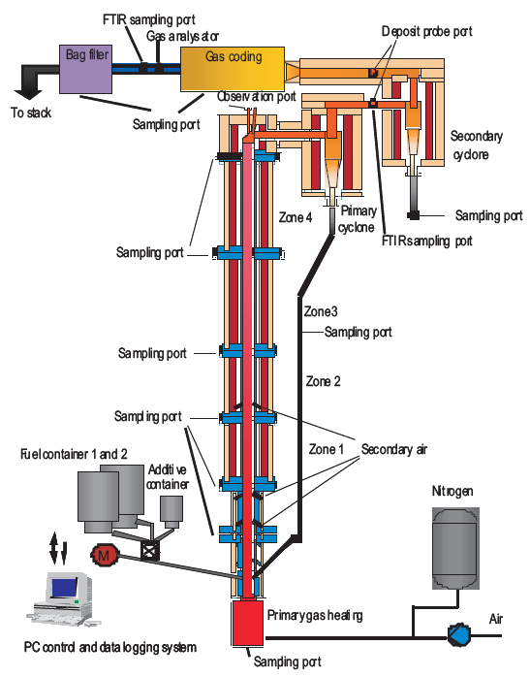
CFB Boiler Optimization

Slide 46
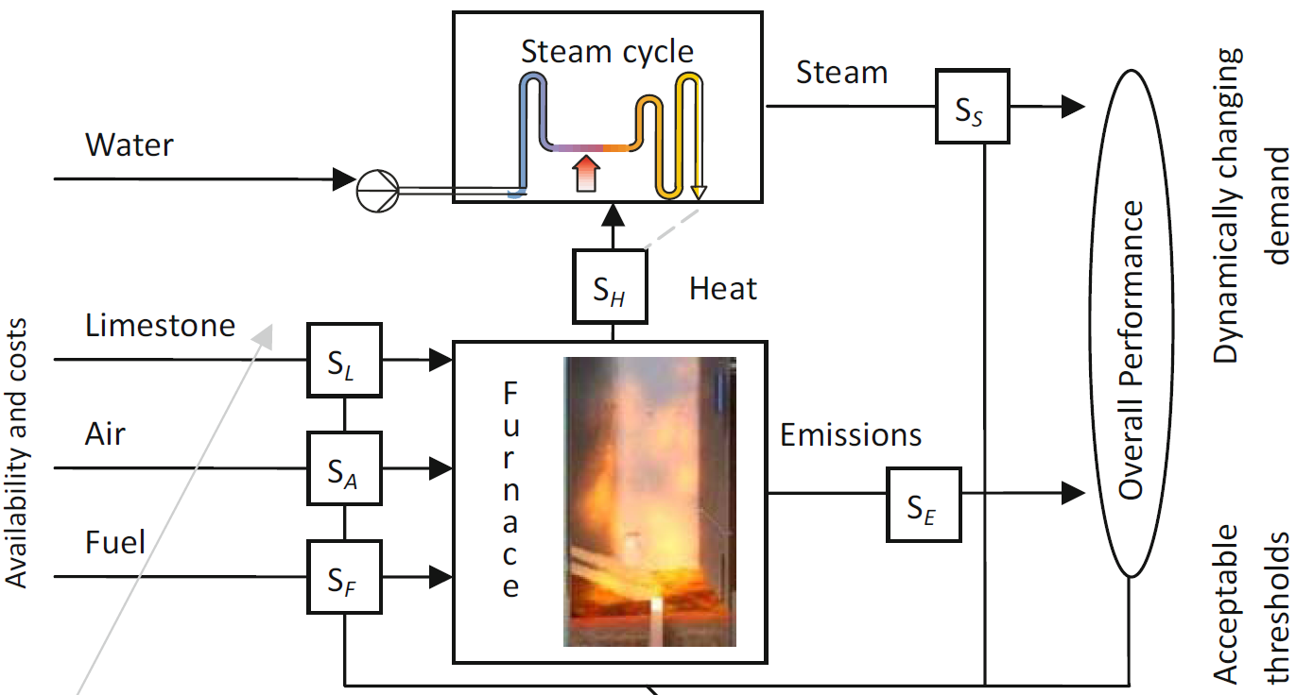
CFB Boiler Optimization

Slide 47
Online Mass Flow Prediction
fluctuation in the signal of the scales => no reliable online data can be obtained from the mass flow of fuel to the boiler
predict the actual mass flow based on the sensor measurements
two phases: feed and burn
Notes:
In addition, we assume that the mass flow signal has a nonzero second deriva-
tive. The speed of the mass change in the container also depends on the amount
of the fuel in the container. The more fuel is in the container, the larger is an
acceleration, thus the more fuel gets in the screw. The weight of the fuel at the
higher levels of the tank compresses (increases the density) the fuel in the lower
levels and in the screw. The size and grade of fuel also have an effect on the
compression rate of the fuel.

Slide 48
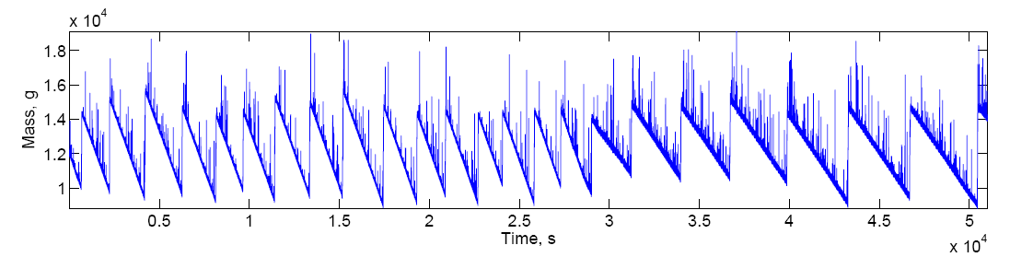
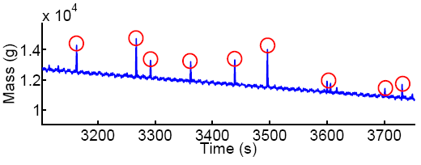
Online Mass Flow Prediction
data collected from a typical experimentation with CFB boiler
asymmetric nature
of the outliers
short consumption
periods within
feeding stages
Pechenizkiy et al.
SIGKDD Expl. 2009
Notes:
Blip drift is a special case of abrupt drift coupled with very short concept duration.
Why adaptivity?
input different types of fuel (coal, bio)
manually
in different proportions
the signal is changing due to complexity of the environment

Slide 49
Solution – use domain knowledge
Adaptive learning approach
Detect a change and cut the training window
Challenges
Specific types of outliers and noise
True change labels are unavailable
3+ component prediction system
Signal model (2nd order regression)
Outlier elimination
Change detection and training window selection
Backtracking
Based on moving average and learnable thresholds
Pechenizhkiy et al, 2009. SIGKDD Explorations 11(2), p. 109-116

Slide 50
Closer Look
Triggering
Evolving
Single classifier
Detectors
Forgetting
Ensemble
Dynamic ensemble
Contextual
adaptive
fusion rules
build many models,
dynamically combine

Slide 51
Dynamic Ensemble
Classifier 1
Classifier 2
vote
Classifier 3
Classifier 4

Slide 52
Dynamic Ensemble
voter 1
time
voter 2
voter 3
voter 4
TRUE

Slide 53
Dynamic Ensemble
punish
voter 1
voter 1
reward
voter 2
voter 2
punish
voter 3
voter 3
reward
voter 4
voter 4
TRUE

Slide 54
Dynamic Ensemble
punish
voter 1
voter 1
reward
voter 2
voter 2
punish
voter 3
voter 3
reward
voter 4
voter 4
TRUE
TRUE

Slide 55
Dynamic Ensemble
punish
voter 1
voter 1
voter 1
reward
voter 2
voter 2
voter 2
punish
voter 3
voter 3
voter 3
reward
voter 4
voter 4
voter 4
TRUE
TRUE

Slide 56
Closer Look
Triggering
Evolving
Single classifier
Detectors
Forgetting
Ensemble
Dynamic ensemble
Contextual
dynamic integration,
meta learning
build many models,
switch models according to the observed incoming data

Slide 57
Dynamic Integration
- partition the training data
- build/select best classifiers for each partition
Group 1 = Classifier 1
Group 3 = Classifier 3
Group 2 = Classifier 2

Slide 58
Dynamic Integration
- find to which partition
the new instance belongs
- assign a classifier that is expected to perform best on it
Group 1 = Classifier 1
Group 3 = Classifier 3
Group 2 = Classifier 2

Slide 59
Which Technique to Use?
Adaptive learning techniques need to assume,
explicitly or implicitly, what change will happen
Changes can be
unexpected => control system is inherently reactive
expected, but exactly unknown
predictable
Changes can be of different types
gradual, sudden, reoccuring
When designing an adaptive prediction system, first determine, what changes are expected
=> Room for proactive
Notes:
Reactive – assume that it may happen, monitor for it and get ready to refine the model

Slide 60
Which Approaches for Which Types
Triggering
(change detection)
Evolving
(adapting every step)
sudden drift
Single classifier
Detectors
Forgetting
variable windows
fixed windows,
Instance weighting
Ensemble
Dynamic ensemble
Contextual
adaptive
fusion rules
dynamic integration,
meta learning

Slide 61
Which Approaches for Which Types
Triggering
(change detection)
Evolving
(adapting every step)
Single classifier
Detectors
Forgetting
variable windows
fixed windows,
Instance weighting
Ensemble
Dynamic ensemble
gradual drift
Contextual
dynamic integration,
meta learning
adaptive
fusion rules

Slide 62
Which Approaches for Which Types
Triggering
(change detection)
Evolving
(adapting every step)
Single classifier
Detectors
Forgetting
reoccuring drift
variable windows
fixed windows,
Instance weighting
Ensemble
Dynamic ensemble
Contextual
adaptive
fusion rules
dynamic integration,
meta learning

Slide 63
An Application Perspective
How well different approaches work in practice
Why we need so many
If there is no ‘one size fits all’ solution to make a predictive system adaptive,
how shall we assemble an adaptive learning system
what properties of application tasks should be considered to make a right design choice

Slide 64
Classical Situation in Early DM\ML
Problem is believed to be important, but
real data is hard to get due to privacy or proprietary (but also laziness) reasons
or the solution is too “generic” such that is it not applicable in practice
or the solution addresses a tiny problem in the overall automated decision making process
At an extreme
There is no real application in mind and it is substituted by an invented real application (“green aliens”)
Notes:
Rephrase no data

Slide 65
As a Consequence:
A lot of research is done on small/toy UCI datasets and simulated/artificial data
Exaggerated in concept drift area: most of early published work reported HCD performance on
Moving Hyperplane and SEA concepts (artificially generated) benchmarks and
UCI datasets “adjusted” for the needs of CD researchers (artificially introduced drift)
Notes:
We do not say that this research is useless or wrong, we say now there is a possibity to look into real applications and work with real data and that it is important to understand what the landscape of different applications is, how applicable a possible solution is, how it can or should be adjusted to the peculiarities of particular application type.

Slide 66
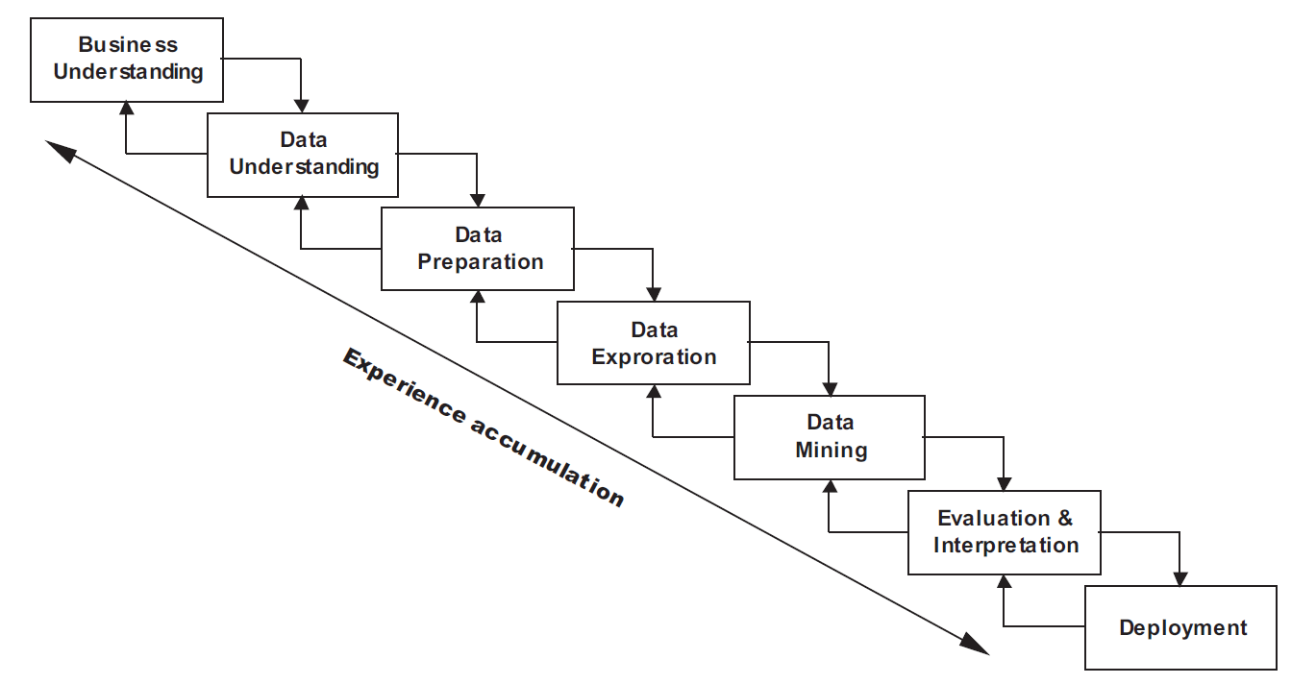
CRISP-DM: Cross Industry Standard Process for Data Mining
Streaming settings and anticipation of CD require an automation of these feedback loops

Slide 67
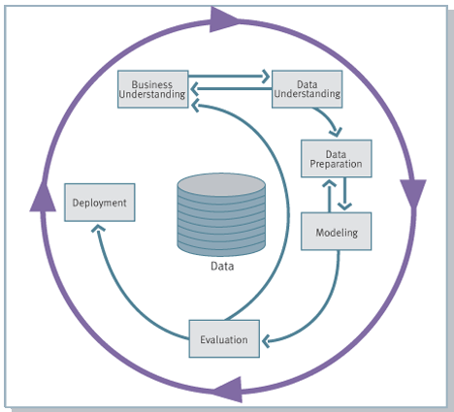
Predictive Analytics: CRISP-DM 1.0
Notes:
Skip if lack of time

Slide 68
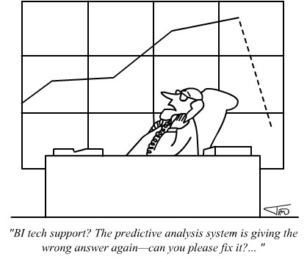
Predictive Analytics: CRISP-DM 1.0

Slide 69

Predictive Analytics: CRISP-DM 1.0
Notes:
Of it we make an example of developing predictive model for a driverless car, we would not like to call a data scientist every time the road conditions change. We want models to be capable of recognizing relevant contexts and adjusting their predictions accordingly.

Slide 70
Predictive Analytics: CRISP-DM 2.0
Evolving data
Performance monitoring
Model adaptation
Context-awareness
Handling concept drift
Notes:
Skip if lack of time

Slide 71
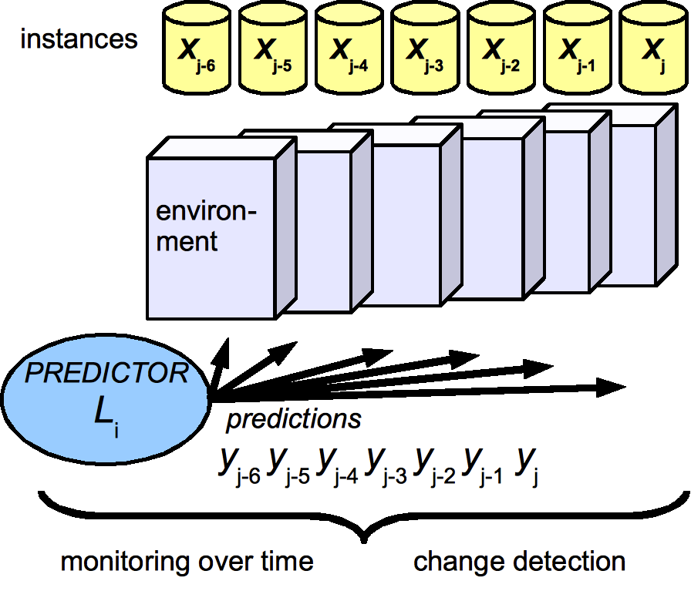
Evolving data: Monitoring for Changes
in Data,
Context &
Predictions

Slide 72
CRISP for Adaptive Data Mining
categorization of applications in which CD matters
Type of learning/mining task, available data and labels, and expectations on type/nature of CD
provide researchers dealing with CD related problems a reference framework for:
positioning their work with respect to the applicability of the techniques in practice
helping young researchers to avoid “green aliens” problem in motivating their work
better see new research directions driven by challenges and opportunities of certain types of real applications where CD matters
Notes:
Provide an application perspective view on handling concept drift
Revisiting Application examples/Case studies
Peculiarities for different kind or applications
What challenges and opportunities they bring

Slide 73
Application Tasks
DATA
CHANGES
How to characterize
an application task,
when designing
an adaptive prediction system?
OPERATION

Slide 74
DATA
DATA
task
detection
classification
prediction
ranking
type
time series
relational
mix
organization
stream/batches
data re-access
missing

Slide 75
CHANGE
DATA
change type
sudden
gradual
incremental
reoccurring
change source
adversary
interests
population
complexity
expectations about changes
unpredictable
predictable
identifiable
CHANGES
expectations about desired action
keep the model uptodate
detect the change
identify/locate the change
explain the change
Notes:
What do we need to do about it – update model – or detect the change, or also locate it and explain it,
Drift Magnitude - the distance between the concepts at the start and end of the period of drift.
Drift Duration
Drift rate, which quantifies how fast the distribution is changing at time t.
Volatility of the stream

Slide 76
OPERATION
DATA
CHANGES
labels
real time
on demand
fixed lag
delay
decision speed
real time
analytical
ground truth labels
soft/hard
costs of mistakes balanced/ unbalanced
OPERATION
Notes:
Task – just be uptodate/accurate, signal that the change happened, locate the change, explain the change, - when, what, why happened

Slide 77
Landscape of Applications
Types of apps Industries | Monitoring/ control | Personal assistance/ personalization | Management and planning | Ubiquitous applications
Security, Police | Fraud, insider trading, or adversary actions detection | -------- | Crime volume prediction | Authentica-tion, Intrusion detection
Finance, Banking, Telecom, Credit Scoring, Insurance, Direct Marketing, Retail, Advertising, e-Commerce | Monitoring & management of customer segments, bankruptcy prediction | Product or service recommendation, including complimentary | Demand prediction, response rate prediction, budget planning | Location based services, related ads, mobile apps
Education (higher, professional, children, e-Learning) Entertainment, Media | Gaming the system, Drop out prediction | Music, VOD, movie, learning object recommendation, adaptive news access, personalized search | Player-centered game design, learner-centered education | Virtual reality, simulations
Notes:
With an example of two apps located at two extremes.
76

Slide 78
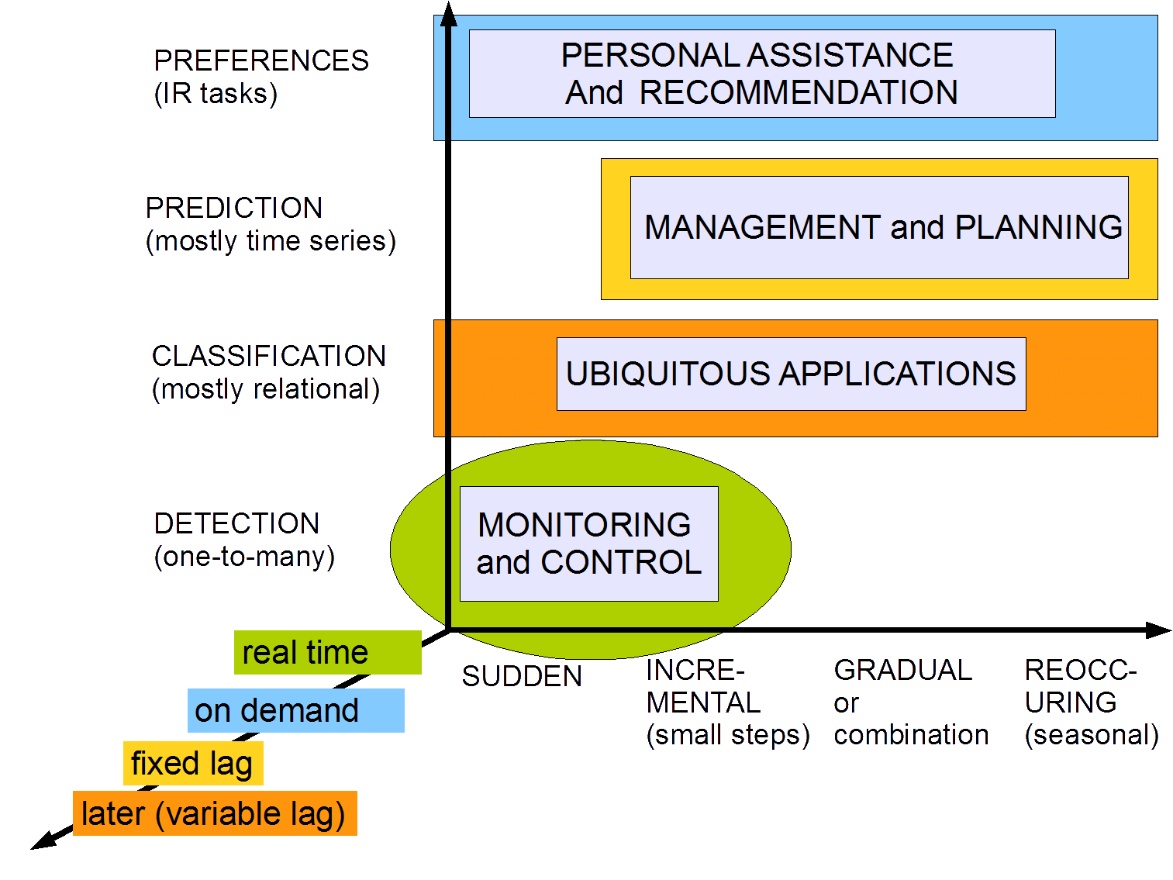
Notes:
Application properties are typical, but not exclusive
It will be always possible to find a contradictory example
Categories are intended to serve as guidelines
For designing adaptive prediction systems
Looking for related work
Determining future research directions

Slide 79
Properties of Applications
 | Monitoring/ control | Personal assistance/ personalization | Management and planning | Ubiquitous applications
DATA Task Input data Incoming Volume Multiple scans Missing values | detection relational batches high no random | ranking relational stream moderate no unlikely | prediction time series stream, iterations moderate yes systemtic | Authentica-tion, Intrusion detection
CHANGE Change source Change type Expectations | adversary sudden unpredictable | preferences gradual, incremental unpredictable | Demand prediction, response rate prediction, budget planning | Location based services, related ads, mobile apps
OPERATION Label speed Costs of mistakes Ground labels | fixed lag unbalanced hard | on demand balnced soft | Player-centered game design, learner-centered education | Virtual reality, simulations
Notes:
With an example of two apps located at two extremes.
Application properties are typical, but not exclusive
It will be always possible to find a contradictory example
Categories are intended to serve as guidelines
For designing adaptive prediction systems
Looking for related work
Determining future research directions
78

Slide 80
Assumed Settings in Most of Research
Change is unpredictable, typically sudden
True labels are available right after casting predictions for verification/relevance feedback
Only one type of change and for a particular reason is anticipated/monitored for
Only one object corresponds to a concept
No closed loop control
No bias due to adaptation
We can replay the history, multiple times if needed to fine-tune the parameters

Slide 81
In Reality
Changes may (re-)occur multiple times
during the analytics lifetime of an object
across multiple objects with related behavior
need to monitor for different kinds of changes
Multi-sensory environment/data,
each somewhat unreliable
but allowing to collaboratively manifest CD
Labels are not (immediately) available
Labels ≠ Ground truth
Background knowledge about the process/ changes may be available
Need to deploy to evaluate/finetune properly

Slide 82
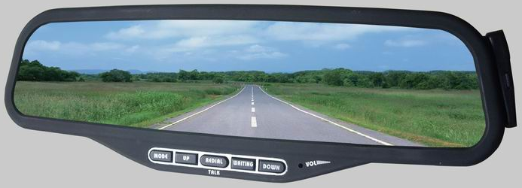
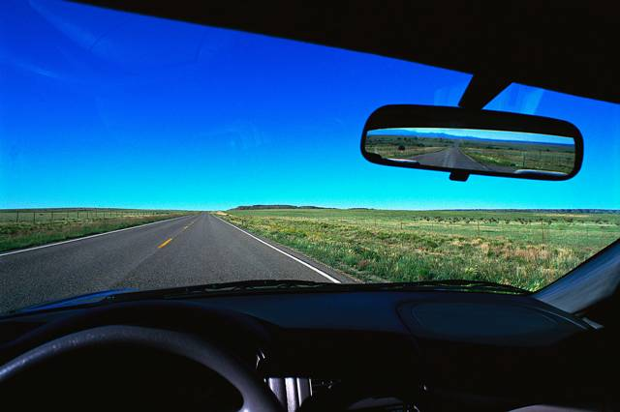
Reactive vs. Proactive methods
Monitoring own recent performance
Monitoring for recurrent contexts
Monitoring performance of peers

Slide 83
Reactive and Proactive Approaches
Reoccuring changes – use mete-learning
recognize & reuse similar situations from the past
Learn from the external data
Multi-sensor environments
Distributed Environments
Predictive handling asynchronous CD by mining temporal associations among peers
Context-awareness
“All models are wrong.”
Find those that are the most useful for this moment.
Notes:
Reactive – assume that it may happen, monitor for it and get ready to refine the model

Slide 84
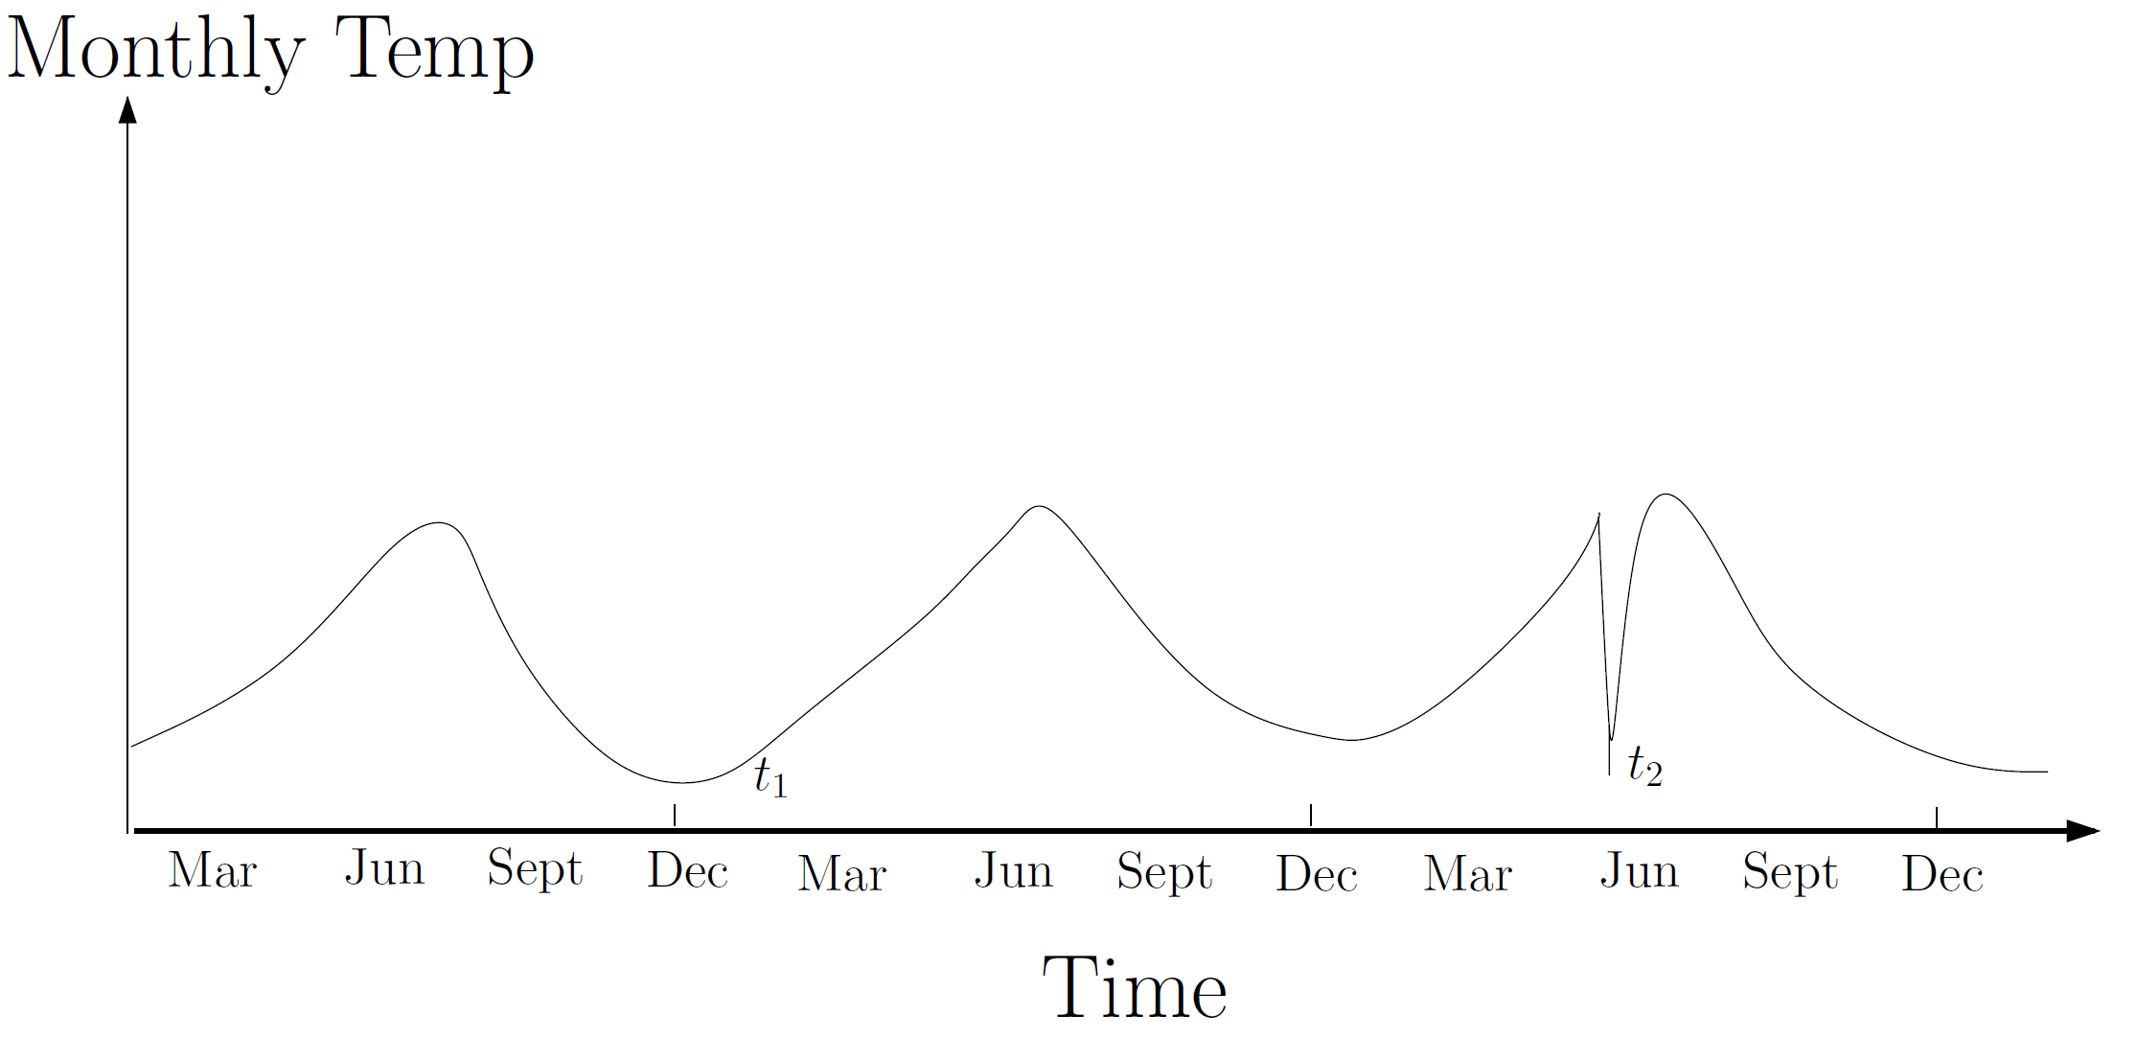
Context in Outlier Detection
If we have seasonality, simple thresholding does not work; need to adjust w.r.t. the season
Notes:
A temperature of 5ºC might be normal during the winter (at t₁) at a place, but the same value during summer (at t₂) at the same place would be an outlier (not any more in NL)
Ice-cream sales instead of monthly temp.
http://www.cs.umn.edu/tech_reports_upload/tr2007/old_files/07-017.pdf

Slide 85
Contexts in Change Detection
Online Mass Flow Prediction in CFB boiler:
Different type of fuel
Subtasks: identify change points and
distinguish them from outliers
Both are difficult due to:
- asymmetric nature
of the outliers
- short consumption
periods within
feeding stages
http://www.win.tue.nl/~mpechen/publications/pubs/PechenizkiySIGKDDExpl09.pdf

Slide 86
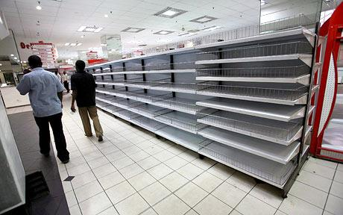
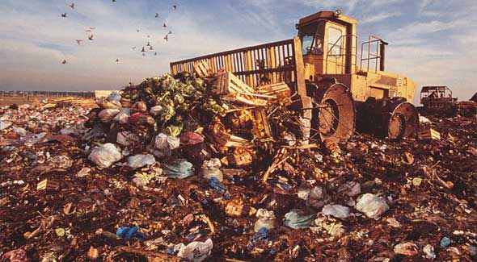
Demand Prediction for Stock Balancing
Prediction
Actual
Empty shelves
vs.
Perishable goods becoming obsolete

Slide 87
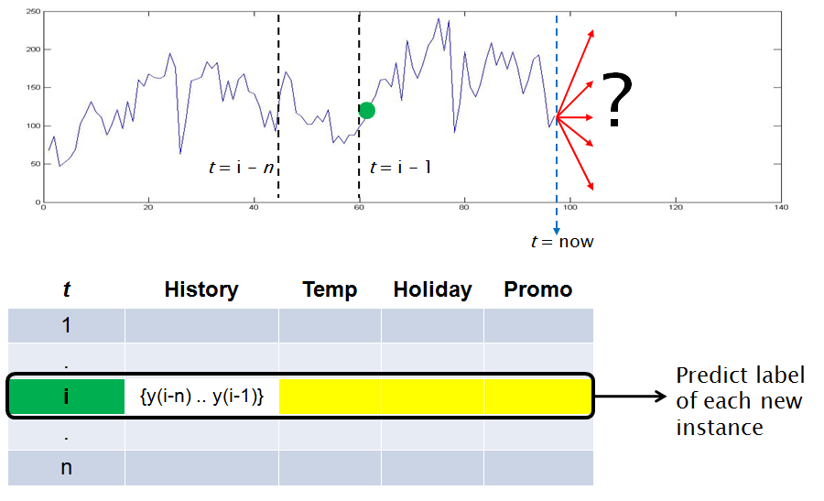
Food Wholesales Prediction

Slide 88
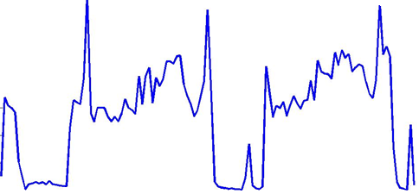
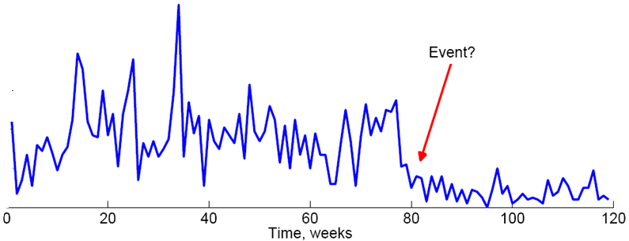
Drifts in Food Wholesales
Reoccurring season

Slide 89
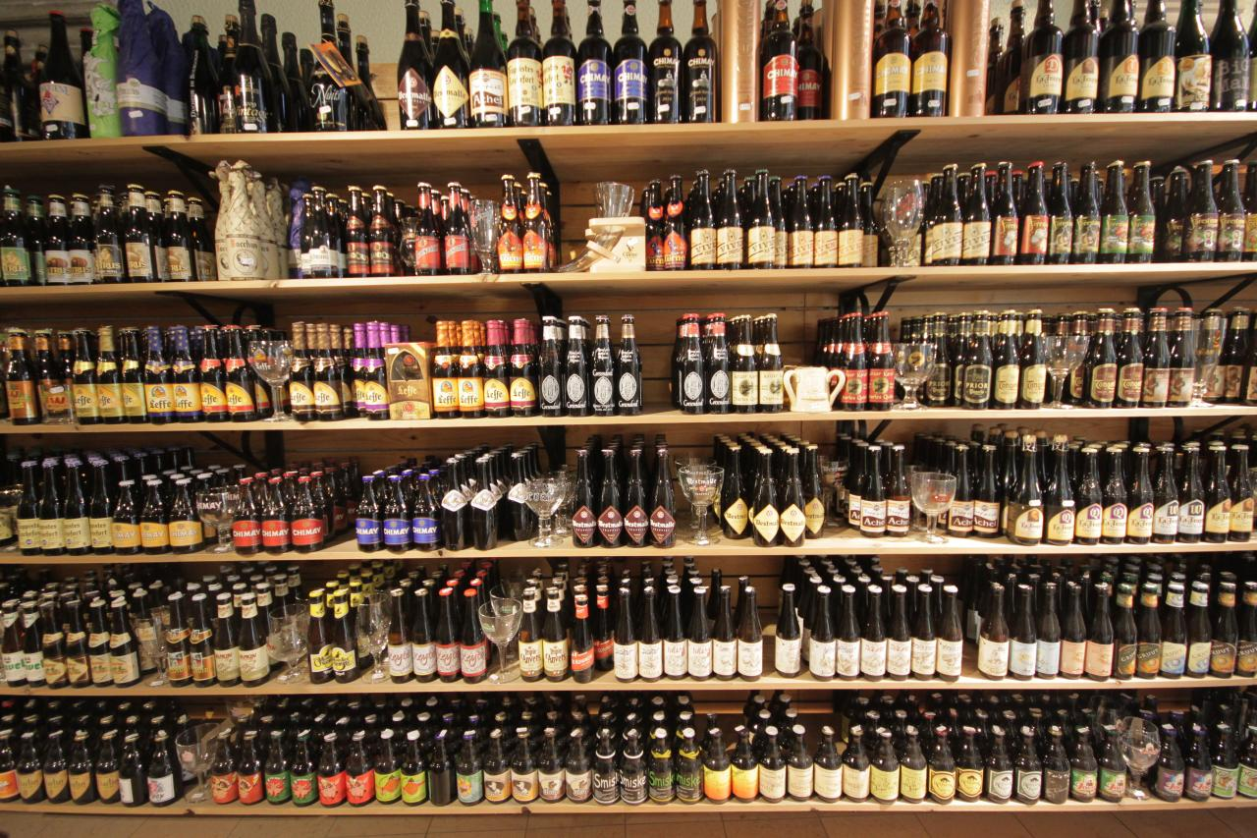
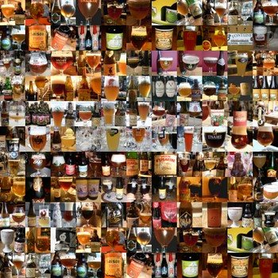
Prediction for Multiple Objects
Identifying related products
Content-based vs. behavioral similarity
Notes:
Changes is demand
In an individual resource adjusting based on observations how other products are behaving
Before moving to Holland I thought that the demand for different kinds of beers would be the same
200+ of Dutch and Belgium beers was an eye opener, summer and fall beer, christmass beer, placing them into the same bukker would be wrong

Slide 90
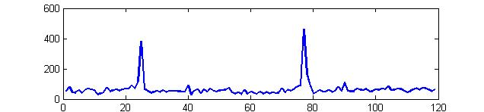
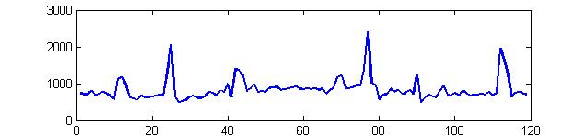






Possible types and prototypes
Occasional
Seasonal
Frequent
Flat
Notes:
89

Slide 91
Distributed Settings
Distributed classification
Disease diagnosis during epidemic outbreaks
epidemic originates from one country and spreads to another with some delay
Weather prediction across different regions
a cyclone brings weather changes moving with a certain speed and direction
How many people are likely (not) to attend a conference due to the weather or covid
ICDM in Dallas was truly international …
Dagstuhl today

Slide 92
Spread of Covid Worldwide
https://www.youtube.com/watch?v=IZWPpKdlonA&ab_channel=GlobalStats

Slide 93





Notes:
Another analogy – warning about traffic jam/accident ahead

Slide 94

Peer-to-peer Handling of Drift
the first peers to ‘suffer’ can share their knowledge with other peers in a controlled manner
(temporal) association exists between peers p1 and p2
Notes:
adapting to changes would be more effective if the first peers to ‘suffer’ can share their knowledge with other peers in a controlled manner

Slide 95
PINE for Asynchronous CD Handling
An ensemble learning approach that combines
reactive adaptation via drift detection, and
proactive handling of upcoming changes via early warning and adaptation across the peers
Frequent sequence mining similar to serial episode mining approach providing e: p_{a}=>p_{b} and post-processing of the episodes to get
the probability a given episode e leading to a local concept drift in p_{b} and
SD of the expected delay leading to the local concept drifts (confidence we have on the expected delay)
Ang et al. 2013. Predictive Handling of Asynchronous Concept Drifts in Distributed Environments, TKDE 25(10)
Notes:
SD of the expected delay leading to the local concept drifts given a matched frequent episode, indicating the confidence we have on the expected delay

Slide 96
Characterizing and Quantifying Drifts
Characterizing Concept Drift. Webb, G. I., Hyde, R., Cao, H., Nguyen, H. L., & Petitjean, F. Data Mining and Knowledge Discovery, 30(4), 964-994, 2016.
Analyzing concept drift and shift from sample data. Webb, G. I., Lee, L. K., Goethals, B., & Petitjean, F. Data Mining and Knowledge Discovery, 32(5), 1179-1199, 2018.
Survey of distance measures for quantifying concept drift and shift in numeric dataOpens in a new window. Goldenberg, I., & Webb, G. I. Knowledge and Information Systems, 60(2), 591-615, 2019.
PCA-based drift and shift quantification framework for multidimensional dataOpens in a new window. Goldenberg, I., & Webb, G. I. Knowledge and Information Systems, 62, 2835-2854, 2020.

Slide 97
A utility-based perspective
Auditing Adaptive Algorithmic Decision Making (ADM)

Slide 98
Predictive analytics that works!?
“All models are wrong, but some are useful”
hard to make 100% accurate ⬄ many trade-offs:
Well formulated and well studied:
precision-recall; bias-variance; robustness-sensitivity;
(not so) well formulated, and not so well studied:
accuracy-computational resources;
accuracy-fairness, accuracy-confidentiality, accuracy-privacy, accuracy-transparency, …
accuracy-human resources: inducing, applying and improving/maintaining does not come for free
Notes:
Machine much faster than human, machine much cheaper than human, much more available than human, and finally often better than human (but does not mean perfect)
Please note that in Kasparov’s example Machine model is not perfect, but is better (on average) than the human player. This brings me to an old famours quote: All models are wrong, but some are useful. But I invite to take a new look at it.
Predictive analytics is useful in both decision making and decision support, because predictive models are useful, they generate better predictions than humans; they can also help to save humans time automating routing predictions.
However, most of these models are still wrong, in a sense that that are not perfect and prone to mistakes, often stupid mistake, systematic mistakes, and also hard to predict mistakes.
Thus, we know that our models are not perfect

Slide 99
Auditing model performance for biases in prediction-based decisions
Detecting, measuring and preventing unfair / discriminating decision making or profiling
Non-uniform accuracy
Error_{males} << Error_{females}
Favoritism in making decisions:
P( + | male) – P( + | female)

Slide 100
Auditing model performance for biases in prediction-based decisions
Detecting, measuring and preventing unfair / discriminating decision making or profiling
Non-uniform accuracy
Error_{males} << Error_{females}
Favoritism in making decisions:
P( + | male) – P( + | female)

Slide 101

Facial Recognition Is Accurate
… if You're a White Guy
8.1% − 20.6% more accurate on male faces
11.8% − 19.2% more accurate on lighter faces
20.8% − 34.7% worse performance on darker female faces

Slide 102

Facial Recognition Benchmarking Study
Notes:
1,270 faces, using faces of lawmakers from countries with a high percentage of women in office. The sources included three African nations with predominantly dark-skinned populations, and three Nordic countries with mainly light-skinned residents.
The African and Nordic faces were scored according to a six-point labeling system used by dermatologists to classify skin types. The medical classifications were determined to be more objective and precise than race.

Slide 103

#GenderShades
“At the time of evaluation, none of the companies tested reported how well their computer vision products perform across gender, skin type, ethnicity, age or other attributes.”
IBM and Microsoft responded within a day after receiving these results
By the time the paper was presented at FATconference the companies reported on the internal investigation and improved performance of their models
Now picked by media, e.g. https://www.nytimes.com/2018/02/09/technology/facial-recognition-race-artificial-intelligence.html
Notes:
- Error analysis reveals 95.9% of the faces misgendered by Face++ were those of female subjects.
- 93.6% of faces misgendered by Microsoft were those of darker subjects
IBM had the largest gap in accuracy, with a difference of 34.4% in error rate between lighter males and darker females.
IBM and Microsoft perform best on lighter males. Face++ performs best on darker males.

Slide 104

Can we find anomalous behavior of models automacally?
Find subgroups on which a classifier performs exceptionally well or exceptionally poor
Exceptional model mining (EMM) approach for finding subgroups for which soft classifier outputs align exceptionally well or bad wrt ground truth
gender = male => acc ↑ (20.6%)
skin = dark ^ gender = female => acc ↓ (34.7%)
W. Duivesteijn, J. Thaele: Understanding Where Your Classifier Does (Not) Work - the SCaPE Model Class for EMM, ICDM 2014
Notes:
Originally used for finding interesting areas to direct attention of astrophysicists. Now, we exploit similar approaches for model performance auditing

Slide 105
Auditing model performance for biases in prediction-based decisions
Detecting, measuring and preventing unfair / discriminating decision making or profiling
Non-uniform accuracy
Error_{males} << Error_{females}
Favoritism in making decisions:
P( + | male) – P( + | female)

Slide 106
Auditing Algorithmic Decision Making (ADM)
population
(source)
Application data
X’
Evidence in data
Descriptive
Decision maker
Y_{G}
Class labels
Evidence in model outputs
Data Scientist
Y_{P}
Class labels
Training data
Feature-value representation
Fairness compliance
Training
classifier
Classification Model L
X
Descriptive
Regulator
A
Protected
Evidence in model logic
Classification techniques
y = L (X, A)
Y_{H}
Class labels
Evidence in algorithm induction
Notes:
What are we trying to audit and to explain?
Interpreting predictions / model performance
Interpreting model decision logic
Interpreting model design principles
We can measure whether model outputs on average are fair
Is it useful? – yes, is it sufficient? – likely not
We can inspect whether a model use protected characteristics
Is it useful – yes and no; 2) is it sufficient – certainly not
We can check the classification techniques and the training process to see what models were favored
4) Give examples for each
Auditing individual predictions / overall model performance
Which features were used for making a prediction
How much each feature (subset) has contributed to the prediction
How well does the model perform wrt accuracy, fairness, privacy-preservation etc.
Auditing model decision logic
- How to simulate the model
Auditing model induction process / design principles

Slide 107
Auditing Adaptive ADM
= ??
population
population
Application data
X’
Evidence in data
Descriptive
Decision maker
Y_{G}
Class labels
Evidence in model outputs
Data Scientist
Y_{P}
Class labels
Training data
Feature-value representation
Fairness compliance
Training
classifier
Classification Model L
X
Descriptive
Regulator
A
Protected
Evidence in model logic
Classification techniques
y = L (X, A)
Y_{H}
Class labels
Evidence in algorithm induction
Notes:
What are we trying to audit and to explain?
Interpreting predictions / model performance
Interpreting model decision logic
Interpreting model design principles
We can measure whether model outputs on average are fair
Is it useful? – yes, is it sufficient? – likely not
We can inspect whether a model use protected characteristics
Is it useful – yes and no; 2) is it sufficient – certainly not
We can check the classification techniques and the training process to see what models were favored
4) Give examples for each
Auditing individual predictions / overall model performance
Which features were used for making a prediction
How much each feature (subset) has contributed to the prediction
How well does the model perform wrt accuracy, fairness, privacy-preservation etc.
Auditing model decision logic
- How to simulate the model
Auditing model induction process / design principles

Slide 108

FAccT in Evolving Data Streams
KDD
AAAI
ICDM
NIPS
ICML
RecSys
InfoViz
CIKM
SDM
WSDM
BIAS’2020 @ECMLPKDD
sites.google.com/ view/bias-2020/
Sept 18, 2020
Challenge:
improving Fairness, Accountability & Transparency in Machine Learning Systems dealing with CD and including adaptation mechanisms
“Anything you can do, AI can do better”
“Anything you can do, AI can help you do better”
Notes:
A Framework for Understanding Unintended Consequences of Machine Learning https://arxiv.org/pdf/1901.10002.pdf
https://arxiv.org/pdf/1803.09010.pdf
Co-Designing Checklists to Understand Organizational Challenges and Opportunities around Fairness in AI
http://www.jennwv.com/papers/interp-ds.pdf
Off-the-shelf and state-of-the-art AI / ML techniques and models which they produce are not neutral and are not fair.
Why? the uncontrolled biases in the training data and/or in the so-called ground truth labels
Scientists from computer science, social sciences, law and humanities look into ways how to formalize and how to operationalize the notions of fairness in AI.
There are many emerging interdisciplinary initiatives for ethical AI, explainable AI, moral AI, humane AI etc.

Slide 109
L-CODE: Labelless CD Detection & Explanation

Slide 110
L-CODE Drift detection
Notes:
Here, we can see the general workflow of our algorithm. We first use labeled data to train a model, then we can build an explainer. By inputting the data into the explainer, we can obtain the corresponding Shapley values.
At time t, we are interested to detect if there is difference between reference window and current window, if drift detected, we will request labels of current window and update the mode. If not, we will extend the reference window.

Slide 111
Summary
Data patterns change over time,
models need to be adaptive to maintain accuracy
Four types of learning techniques
make different assumptions about the data and change
may be optimal in different situations
Application tasks have different properties =>
pose different challenges,
require different handling techniques,
there is no “one size fits all” solution
Notes:
The problem of concept drift has been recognized in different application domains.
Further interest to adaptive learning has been boosted by the outcomes of several recently
organized contests or challenges in AI (controlling driverless cars at the DARPA
challenge), data mining and knowledge discovery (credit risk assessment competition
at PAKDD’09), and recommender systems (Netflix movie recommendation) fields.Winning
teams in each of these competitions emphasize that one of key factors in their success
was due to addressing temporal dynamics and various (hidden) contexts affecting
their concepts of interest. Therefore, we also referred to the conceptual categorization
of typical application settings in which adaptive learning systems have to operate
and discussed the lessons learnt from the real world cases of handling concept drift.

Slide 112
Outlook
Changing the focus from blind adaptivity
to change/CD modeling and description
to recognizing & reusing similar situations from the past and from the peers
Application driven concept drift problems, like
label unavailability or delay in availability
cost-benefit trade off of the model update
controlled adaptivity (due to adversaries)
lack of ground truth for training
A CRISP-ADM reference framework and guidelines
for incorporating adaptivity in modeling
to be used in different application tasks
Notes:
Most of the work on concept drift assumes that the changes happen in hidden context
that is not observable to the adaptive learning system. Hence, concept drift is
considered to be unpredictable and its detection and handling is mostly reactive. However,
there are various application settings in which concept drift is expected to reappear
along the time line and across different objects in the modeled domain. Seasonal
effects with vague periodicity for a certain subgroup of object would be common e.g.
in food demand prediction [Zliobaite et al. 2012a]. Availability of external contextual
information or extraction of hidden contexts from the predictive features may help to
better handle recurrent concept drift, e.g. with use of a meta-learning approach [Gama
and Kosina 2011]. Moreover, transfer learning between the different contexts seems a
potential research line.
Temporal relationships mining can be used to identify related drifts, e.g. in the distributed
or peer-to-peer settings in which concept drift in one peer may precede another
drift in related peer(s) [Ang et al. 2012]. In all these settings more accurate,
more proactive and more transparent change detection may become possible.
The vast majority of the work on concept drift detection summarized in this survey
does not address the problem of representation bias that is common to most of the
adaptive systems that enforce or suggest particular type of behavior. Whenever there
is a reinforcement feedback or a closed-loop control of the learning mechanism, we
cannot evaluate and compare the performance of concept drift handling techniques by
replaying historical data. Therefore, we can speculate that there will be more studies
that try to embed concept drift handling technique in real operational settings for
proper validation.

Slide 113
Next Steps/Challenges
Validate the performance of adaptive learning systems in real application settings on real data
Understand why current approaches do not address some of the application needs
Improve usability and trust
Integrate domain knowledge
Provide transparency, explanation and control for
How changes are detected
How changes are handled, how models are adapted
Visualization of drift, explanations, business logic
Notes:
accuracy, safely, stability in variety of settings

Slide 114
Take Home Messages
Predictive models should anticipate and adapt to changes
Many techniques exist for reactive adaptation based on change detection; no one size fits all
Variety of applications/operational settings, some of which are being addressed, but still
Lots of challenges and opportunities for better HCD
A system-oriented perspective is lacking
Context-awareness may become an answer
Notes:
Linking discovered context into predictive modeling
or
Context-aware adaptation of predictive modeling

Slide 115
How Can We Explain Change?
Do change detection as well as a (rule-based) early classification for the same problem
Linking detected changes to context
Multi-modal affective data example
E.g. stress analytics, mining lifestyle patterns

Slide 116


Stress Analytics
Be-eep!
You are getting stressed!
Notes:
Philips develops a device measuring and recording vital signs like skin conductivity (GSR) and heart rate, with a high frequency

Slide 117




Stress Analytics
Make people aware of their stress and stressors
Overview of stressors
Exploration of relations
Access to evidence, i.e. annotated, measured stress
Empowerment by awareness (+ implicit/explicit advice)

Slide 118








Stress Analytics Framework
What, When, Where, with Whom
Physiological signs
Pattern Mining
OLAP cube

Slide 119


How to Measure Stress
Determine stress level
based on observed
sweat production

Slide 120

Detection and Categorization of Stress
Based on GSR data alone - not as easy as the following figure may suggest:
Notes:
it is not that easy in online and even offline settings

Slide 121


Challenges in Stress Detection
All kinds of noise, e.g. loosing contact with the skin
Activity (exercising) , environment (cold/hot) context and personal differences may impact GSR we observe

Slide 122


Interpretation isn’t Straightforward

Slide 123

Detection as Classification
GSR features
Mean, SD, min and max of GSR.
Mean, min and max of peak height.
Total number of GSR response.
The sum of GSR amplitude.
The sum of rising time response.
The sum of energy response.

Slide 124

Adding More Data to Disambiguate
Skin and room temperature, noise, accelerometer, voice, face, …

Slide 125





Activity Recognition Can Help
Writing vs. typing vs. walking vs. teaching vs …
Analyzing accelerometer data only? (wrist band)
Notes:
vs. monitoring cameras vs GPS etc
Running from Auditorium to

Slide 126


Aligning of Data Sources
60 seconds
GSR
Instance 1
Instance 2
Instance 3
speech
Instance 1
Instance 2
Instance 3

Slide 127
Speech Features
Loudness: volume, intensity and energy
Voice & unvoiced speech: vibration of vocal cord vs. breathing/air flow
Pitch: intonation
Mel Frequency Cepstral Coecients (MFCCs):
mean, variance, min and max values of the largest coefficients from
the Fast Fourier Transform (FFT) + Discrete Cosine Transform (DCT) with some scaling
Preliminary results: more discriminative, but also more user specific
Notes:
Feed to a classifier
Support Vector Machine and Gaussian Mixture Model, Logistic regression as a meta-classifier
Voiced sounds are produced by the vibration of vocal cord
Unvoiced sounds are produced by the rapid flow of air through the nose or teeth.

Slide 128
Uncontrolled and Semi-controlled
Philips Research employees wearing the device during their working hours
Students taken written and multiple choice exams
Students presenting demos/posters with course project results
Schools and college teachers

Slide 129




Is Acute Stress Good or Bad?

Slide 130



What is the Relaxation Then?

Slide 131



Is “Normal” Condition Good or Bad?
What if someone’s patterns looks like NNNNNNNNNNNNNNNN ……

Slide 132
Topics not covered
Online detection of recurrent changes
Transfer learning
Concept drift in unsupervised learning
Pattern mining and clustering
Mining temporal networks
Monitoring statistical properties, e.g. centralities

Slide 133
Bibliography – General Background
Characterizing Concept Drift. Geoffrey I. Webb, Roy Hyde, Hong Cao, Hai Long Nguyen, Francois Petitjean http://arxiv.org/abs/1511.03816
A Survey on Concept Drift Adaptation, Gama, J., Žliobaite, I., Bifet, A., Pechenizkiy, M. & Bouchachia, A. ACM Computing Surveys, 2014
Detection of Abrupt Changes - Theory and Application, M. Basseville, I. Nikiforov, Prentice-Hall, Inc. 1993.
Statistical Quality Control, E. Grant, R. Leavenworth, McGraw-Hill, 1996.
Continuous Inspection Scheme, E. Page. Biometrika 41 1954
Learning in the Presence of Concept Drift and Hidden Contexts, G.Widmer, M. Kubat: Machine Learning 23(1): 69-101 (1996)
Learning drifting concepts: Example selection vs. example weighting, R.Klinkenberg, IDA 2004
Adaptive Learning and Mining for Data Streams and Frequent Patterns, Albert Bifet, PhD Thesis, 2009
Adaptive Training Set Formation, Indre Žliobaitė, PhD Thesis, Vilnius University, Lithuania, 2010.

Slide 134
Bibliography - Approaches
Modelling recurrent events for improving online change detection, by Maslov et al, SIAM SDM 2016
BLPA: Bayesian Learn-Predict-Adjust Method for Online Detection of Recurrent Changepoints, by Maslov et al., IJCNN 2017
Predictive Handling of Asynchronous Concept Drifts in Distributed Environments, by Ang, H., Gopalkrishnan, V., Žliobaite, I., Pechenizkiy, M. & Hoi, S., IEEE Transactions on Knowledge and Data Engineering (2013)
Mining Time-Changing Data Streams, by G. Hulten, L. Spencer, P. Domingos, ACM SIGKDD, 2001.
Dynamic Weighted Majority: A New Ensemble Method for Tracking Concept Drift, by J. Kolter, M. Maloof, ICDM 2003.
Mining Concept Drifting Data Streams using Ensemble Classiers, by H.Wang, Wei Fan, P. Yu, J. Han, ACM SIGKDD 2003.
Decision Trees for Mining Data Streams, by J. Gama, R. Fernandes, R.Rocha. Intelligent Data Analysis 10(1):23-45 (2006)
OLINDDA: A cluster-based approach for detecting novelty and concept drift in data streams. Spinosa, E.J., Carvalho, A., and Gama, J. 22nd ACM SAC 2007: ACM Press.
An Ensemble of Classifiers for Coping with Recurring Contexts in Data Streams, by Katakis, I., Tsoumakas, G., and Vlahavas, I.. in 18th ECAI. 2008, IOS
Dealing with concept drifts in process mining, IEEE Trans. on Neural Networks and Learning Systems, by JC Bose, R., van der Aalst, W., Zliobaite, I. & Pechenizkiy, M. (2013)

Slide 135
Bibliography - Applications
An overview of concept drift applications, Žliobaite, I., Pechenizkiy, M. & Gama, J., In Big Data Analysis: New Algorithms for a New Society, Springer, 2016, http://www.win.tue.nl/~mpechen/publications/pubs/ZliobaiteCDApps2015.pdf
Collaborative Filtering with Temporal Dynamics Yehuda Koren, KDD 2009, ACM, 2009
MOA: Massive online analysis, a framework for stream classification and clustering. Albert Bifet, Geoff Holmes, Bernhard Pfahringer, Philipp Kranen, Hardy Kremer, Timm Jansen, Thomas Seidl, HaCDAIS Workshop ECML-PKDD 2010
Online Mass Flow Prediction in CFB Boilers with Explicit Detection of Sudden Concept Drift. Pechenizkiy, M., Bakker, J., Žliobaitė, I., Ivannikov, A., Karkkainen, T. SIGKDD Explorations 11(2), p. 109-116, 2009.
Dynamic Integration of Classifiers for Handling Concept Drift, Tsymbal, A., Pechenizkiy, M., Cunningham, P. & Puuronen, S. Information Fusion, Special Issue on Applications of Ensemble Methods, 9(1), pp. 56-68, 2008.
Real-time algorithm for changes detection in depth of anesthesia signals. R. Sebastião et al. Evolving Systems 4(1): 3-12 (2013)

Slide 136
Advanced for proactive
Meta-learning for recurring
Peer-to-peer
Stress – context-aware stress detection/prediction
Multimodal data

Slide 137



Context in Understanding Stress@work
http://www.win.tue.nl/stressatwork/

Slide 138

Understanding User Needs

Slide 139
Real vs. Virtual Drifts vs. Novelty
Novelty
circles represent instances (X),
different colors represent different classes (y)
concept drift between t₀ and t₁:
changes affecting predictions require adaptation
generative models fit better to capture novelty
Notes:
- the prior probabilities of classes p(y) may change,
- the class conditional probabilities p(Xjy) may change, and
- as a result, the posterior probabilities of classes p(yjX) may change affecting the prediction
the input data characteristics or the relation between the input data and the target variable may change
From a predictive perspective only the changes that affect the prediction
decision require adaptation
The real concept drift refers to changes in
the conditional distribution of the output (i.e., target variable) given the input (input
features), while the distribution of the input may stay unchanged. A typical example
of the real concept drift is a change in user’s interests when following an online news
stream. Whilst the distribution of the incoming news documents often remains the
same, the conditional distribution of the interesting (and thus not interesting) news documents for that user changes.
Originally a virtual drift has been defined [Widmer and Kubat 1993] to occur
due to incomplete data representation rather than change in concepts in reality,
— Virtual drift corresponds to change in data distribution that leads to changes in
the decision boundary [Tsymbal 2004],
— Virtual drift is a drift that does not affect the target concept [Delany et al. 2005],
— Virtual drift has been also referred to as temporary drift [Lazarescu et al.
2004],sampling shift [Salganicoff 1997] and feature change [Gao et al. 2007],

Slide 140
todo
Outlook
Auditing Adaptive ADM
Explaining change, L-CODE Labeless paper, Webb papers on characterizing drift
CD in Continual learning and lifelong learning
Deep learning
Recurrent
Theory vs, practice, green alience example
Covid examples
Notes:
https://futurism.com/the-byte/pandemic-confused-machine-learning-systems

Slide 141

Identifying Worthy Content

Slide 142


Classify e-mails into “Spam” vs. “Inbox”
Inbox
Spam
Spam
? Contains:
“$1mln”, “Viagra”,
”prescription”, “renew”
...
Inbox
Spam
Inbox
no
yes
Inbox
Spam

